Slide 1
Climate change data exploration
Visual exploration and insights on climate indicators over time
By Patrick Schütten and Tiago Martins

Slide 2
Questions we want to answer:
1 - What changes can we observe in the world’s global temperature since the beginning of the 20th century.
2 - Is there a correlation between countries’ average temperatures and their levels of CO2 emissions?
3 - Are the different countries of the world equally impacted by the rising temperatures?
4 - Hypothesis testing : Comparing two different mean rising temperatures from two different countries.
5 - Hypothesis testing : Comparing the global average temperatures and a specific country average temperatures.

Slide 3
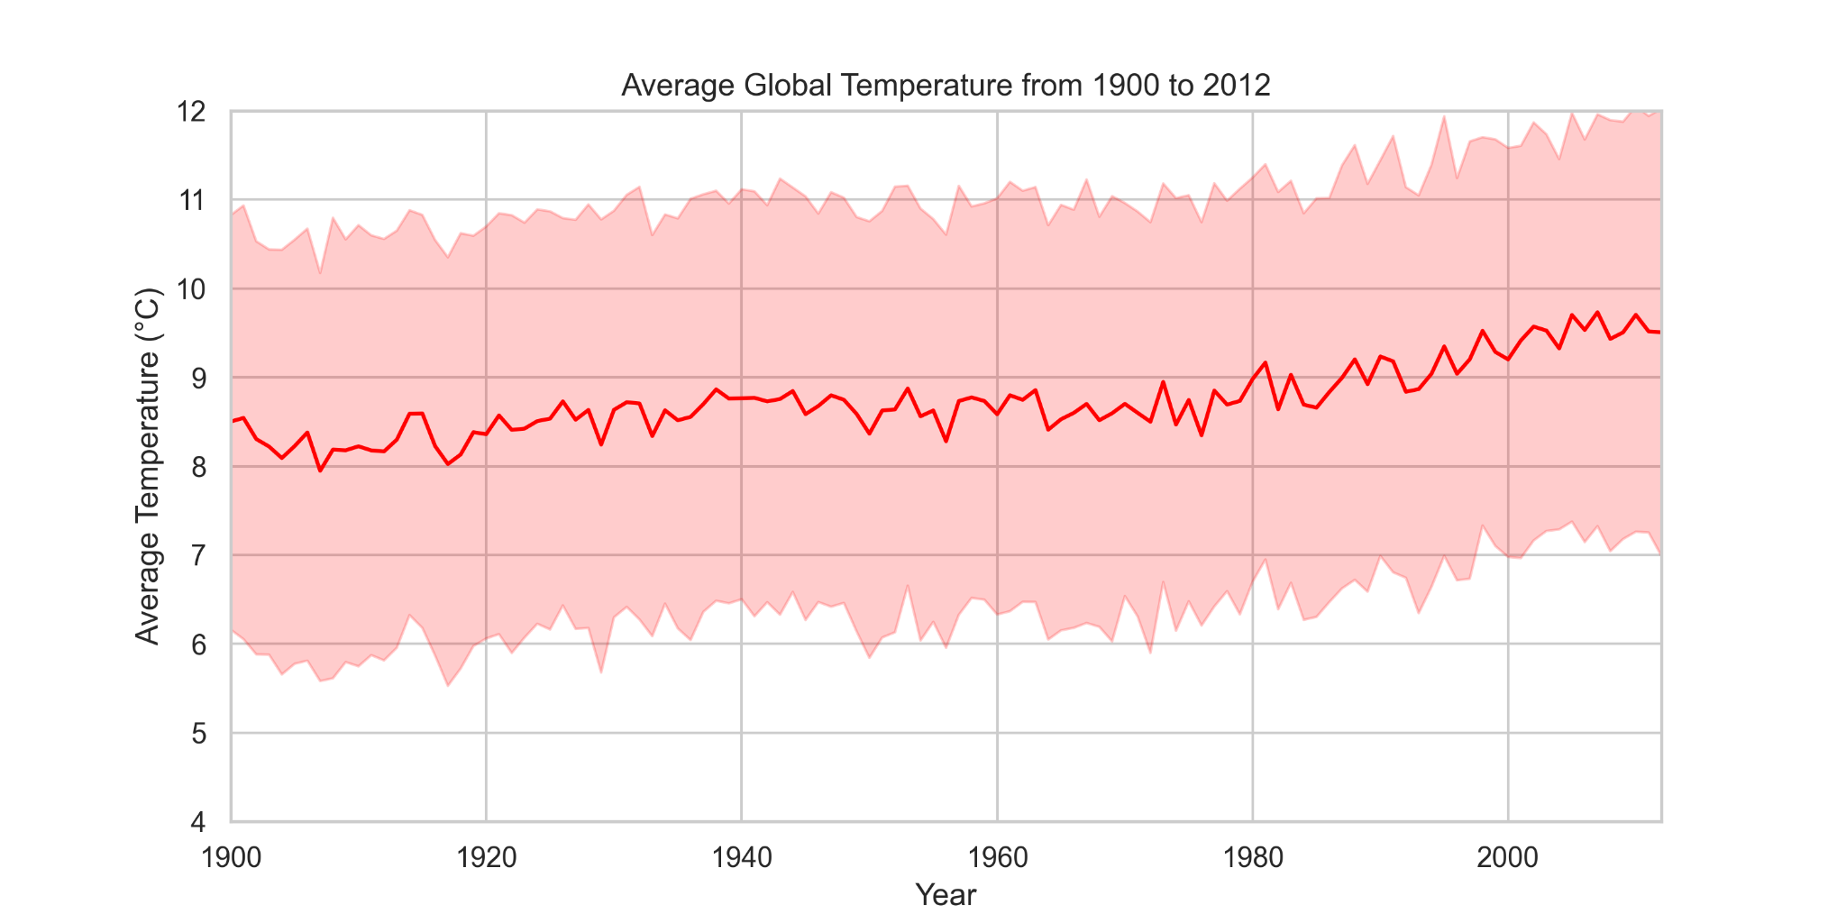
1 - What changes can we observe in the world’s global temperatures since the beginning of the 20th century.
We can see by the left graph a clear upward trend in the average global temperatures (from around 8,5ºC in 1900 to around 9,5ºC in 2012).
We can also see that there are periods where the temperatures fluctuate for a period of years.
*The red line represents the average temperature and the shadowed light red area represents the variance of the temperature (minimum and maximum temperatures each year)

Slide 4
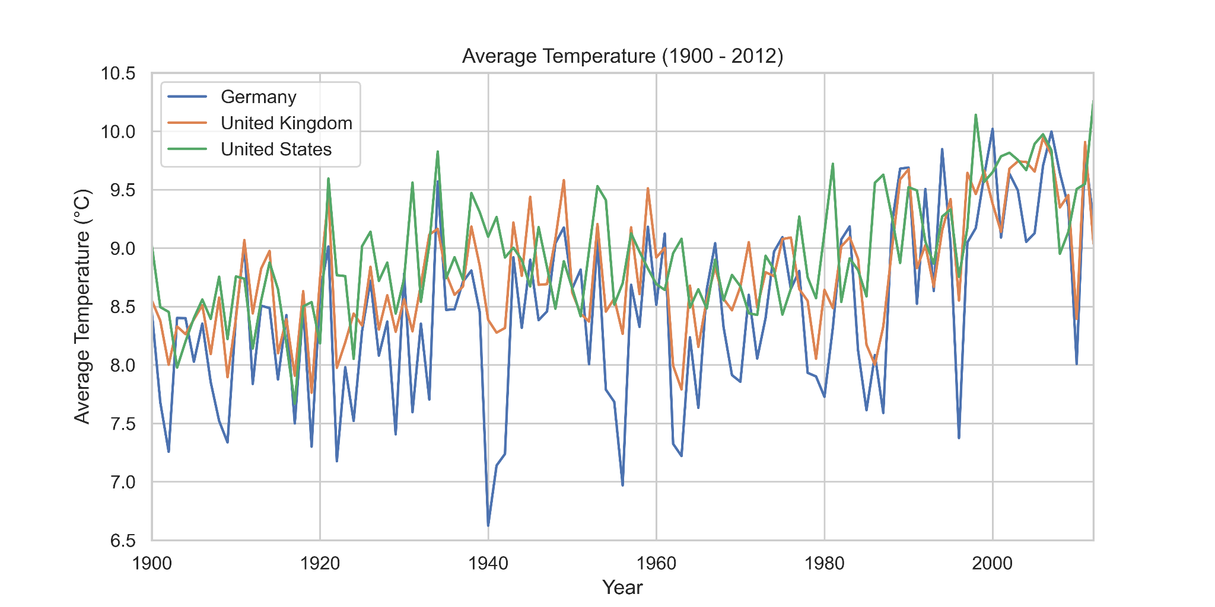
In this graphic, showing the average temperatures for a group of 3 countries, we can better see the variance in values we observed in the plot with global average temperatures.
Notes:
Why we take these 3 countries? Because of similar average temperature

Slide 5
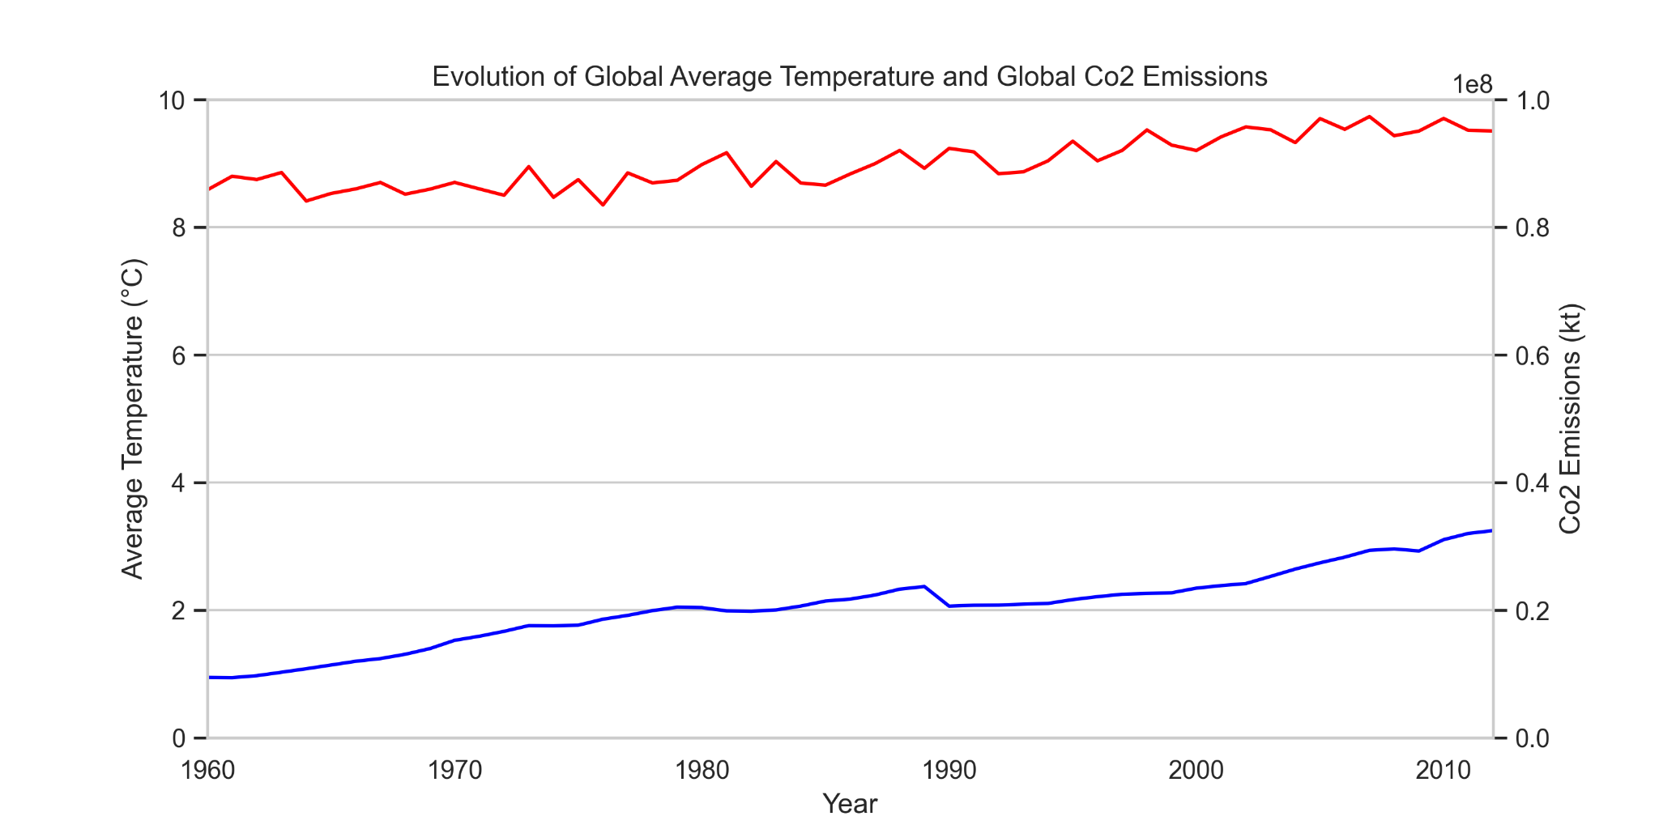
2 - Is there a correlation between the countries’ average temperatures and their levels of CO2 emissions?
Taking into account a different variable like global CO2 emissions and plotting it with the global variation of average temperature we can see there’s a correlation between both values.
We decided then to check if we can visually observe a correlation between a group of countries’ CO2 emissions and the changes in average temperature for those countries over a period of years.

Slide 6
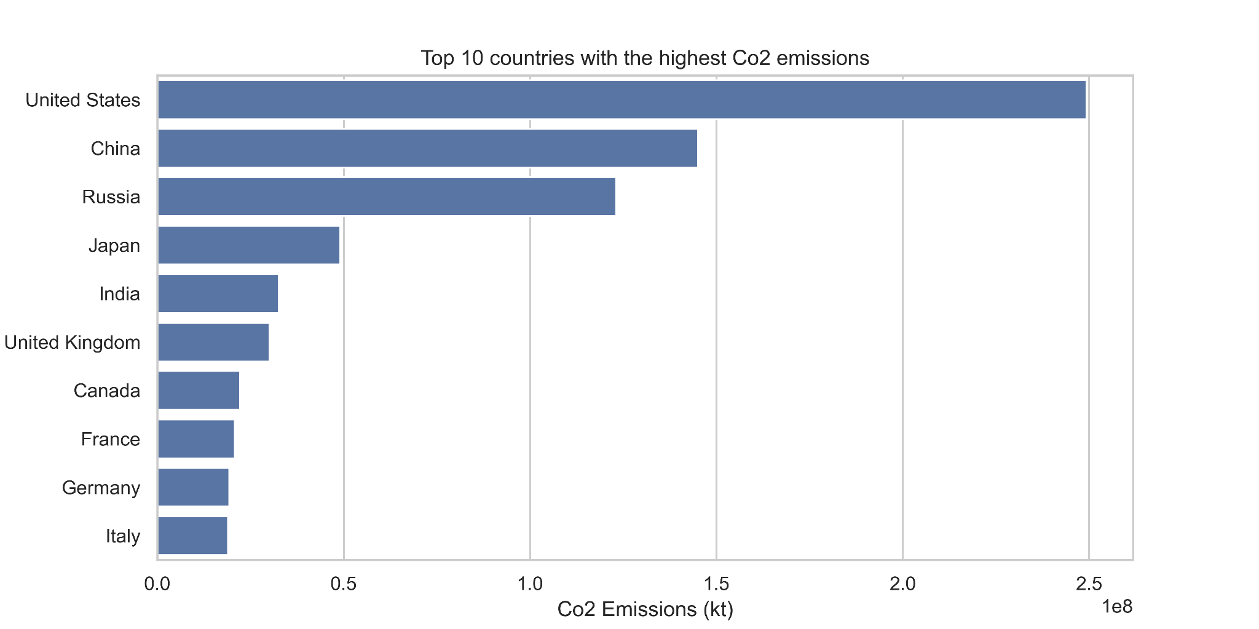
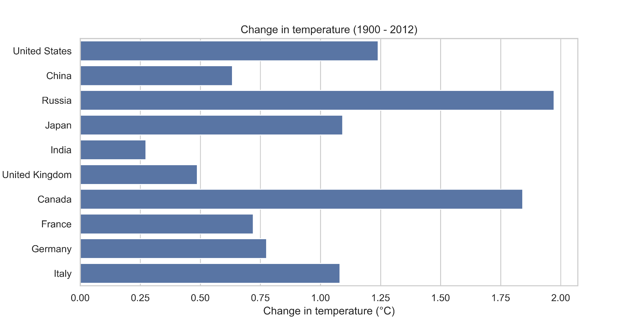
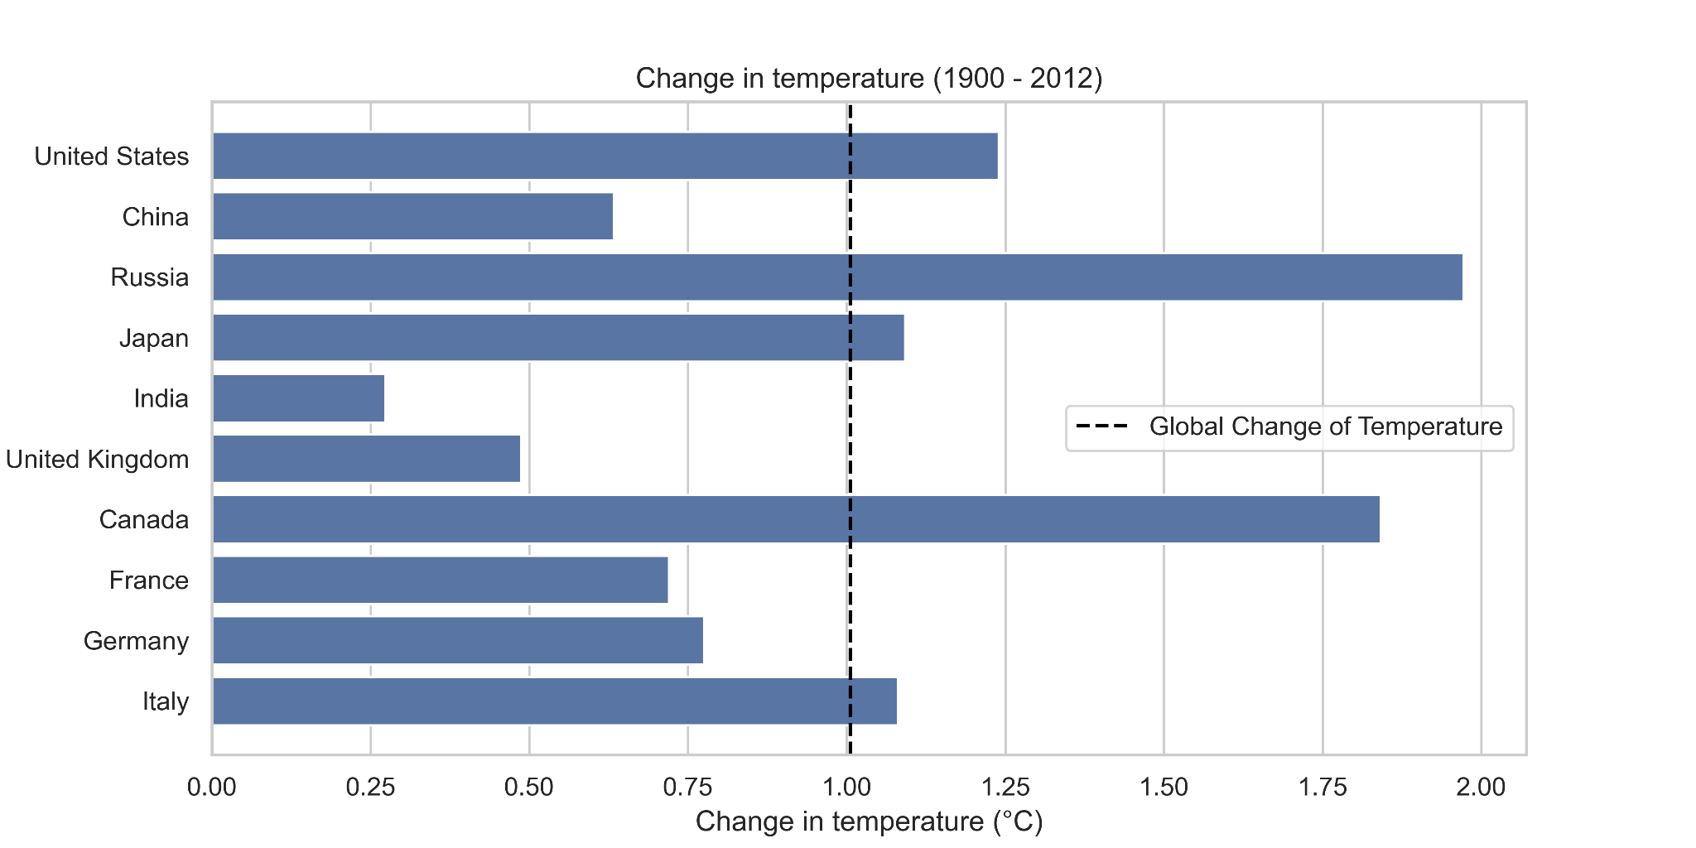
On the left graph we can see the top 10 countries with the most CO2 emissions in descending order and on the right we can see the changes in temperatures for those same countries.
We can see by these plots that the countries with the highest amount of CO2 emissions are not necessarily the ones with highest average temperature increase.

Slide 7
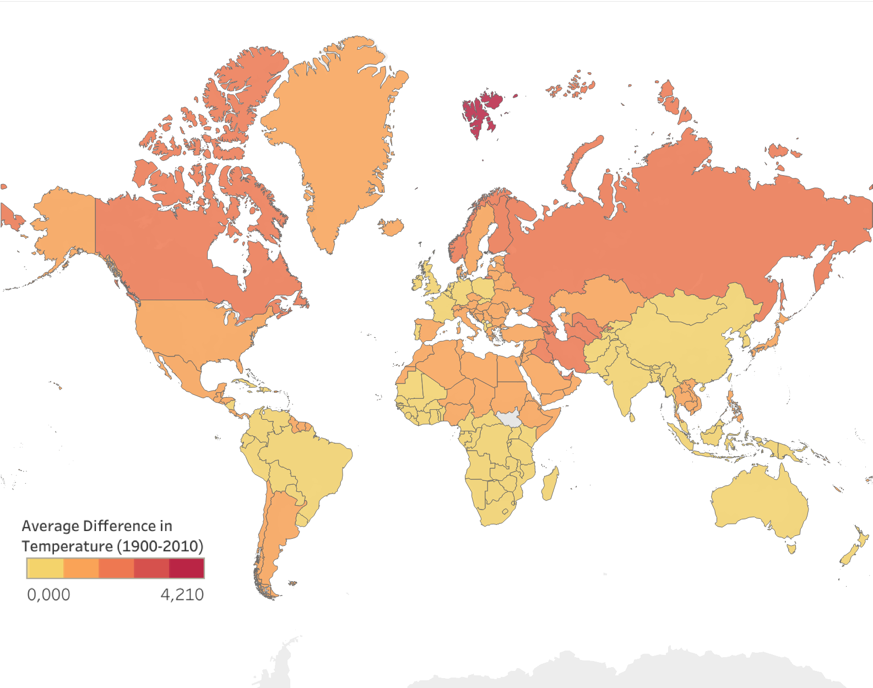
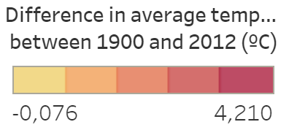
3 - Are the different countries of the world
equally impacted by the rising temperatures?
When analyzing the world map plot on the left we can see some disparity in the way the countries are affected by the rising temperatures.
It appears to show that the regions on the northern hemisphere have a bigger increase in average temperature although there are lot of dependencies that might influence the climate in the different countries.

Slide 8
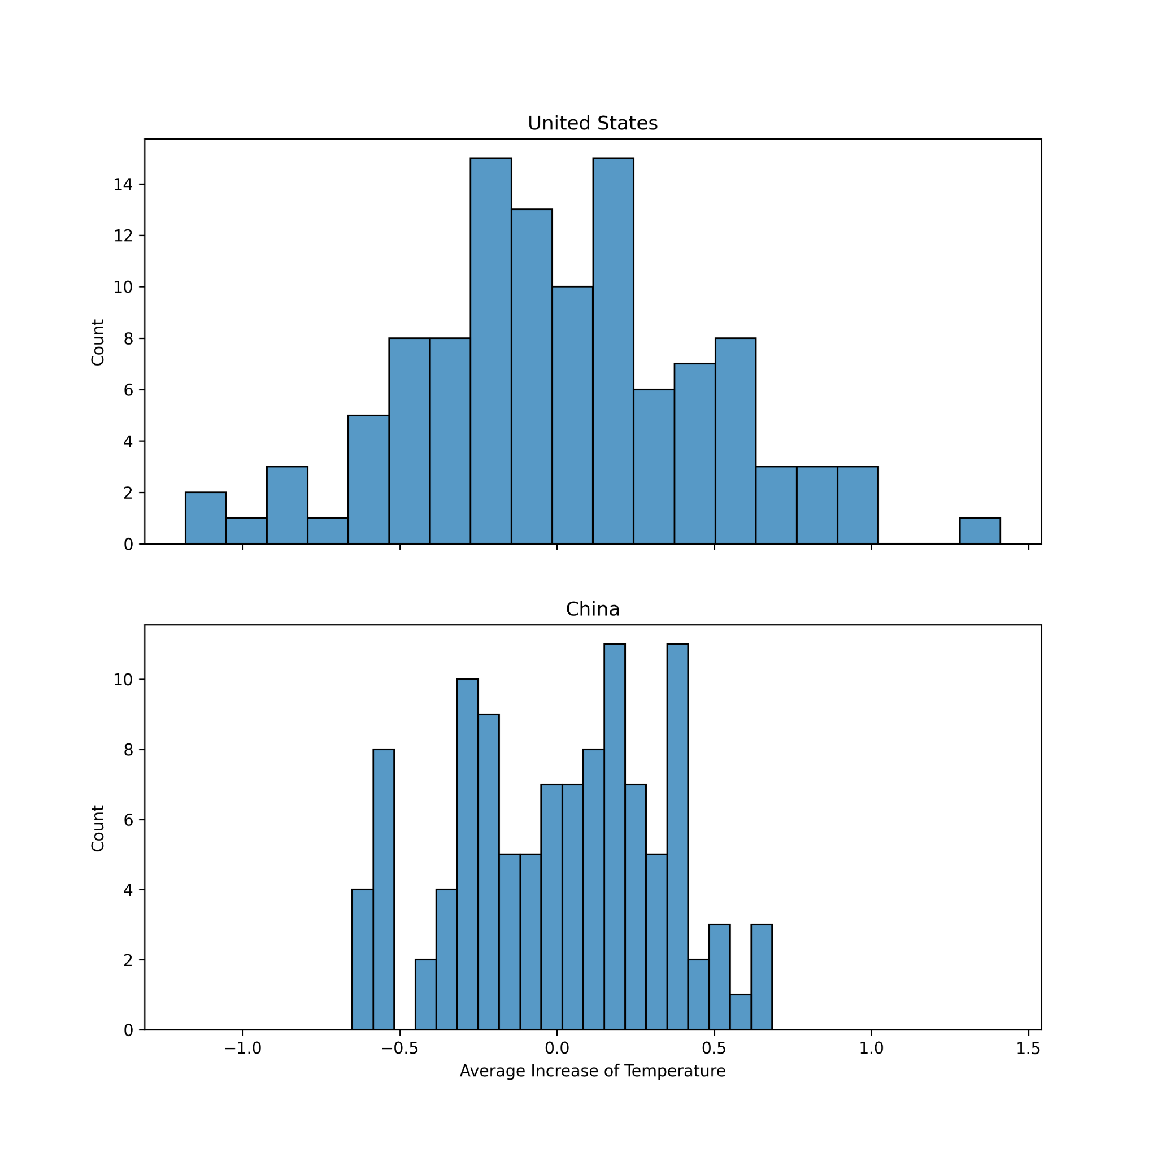
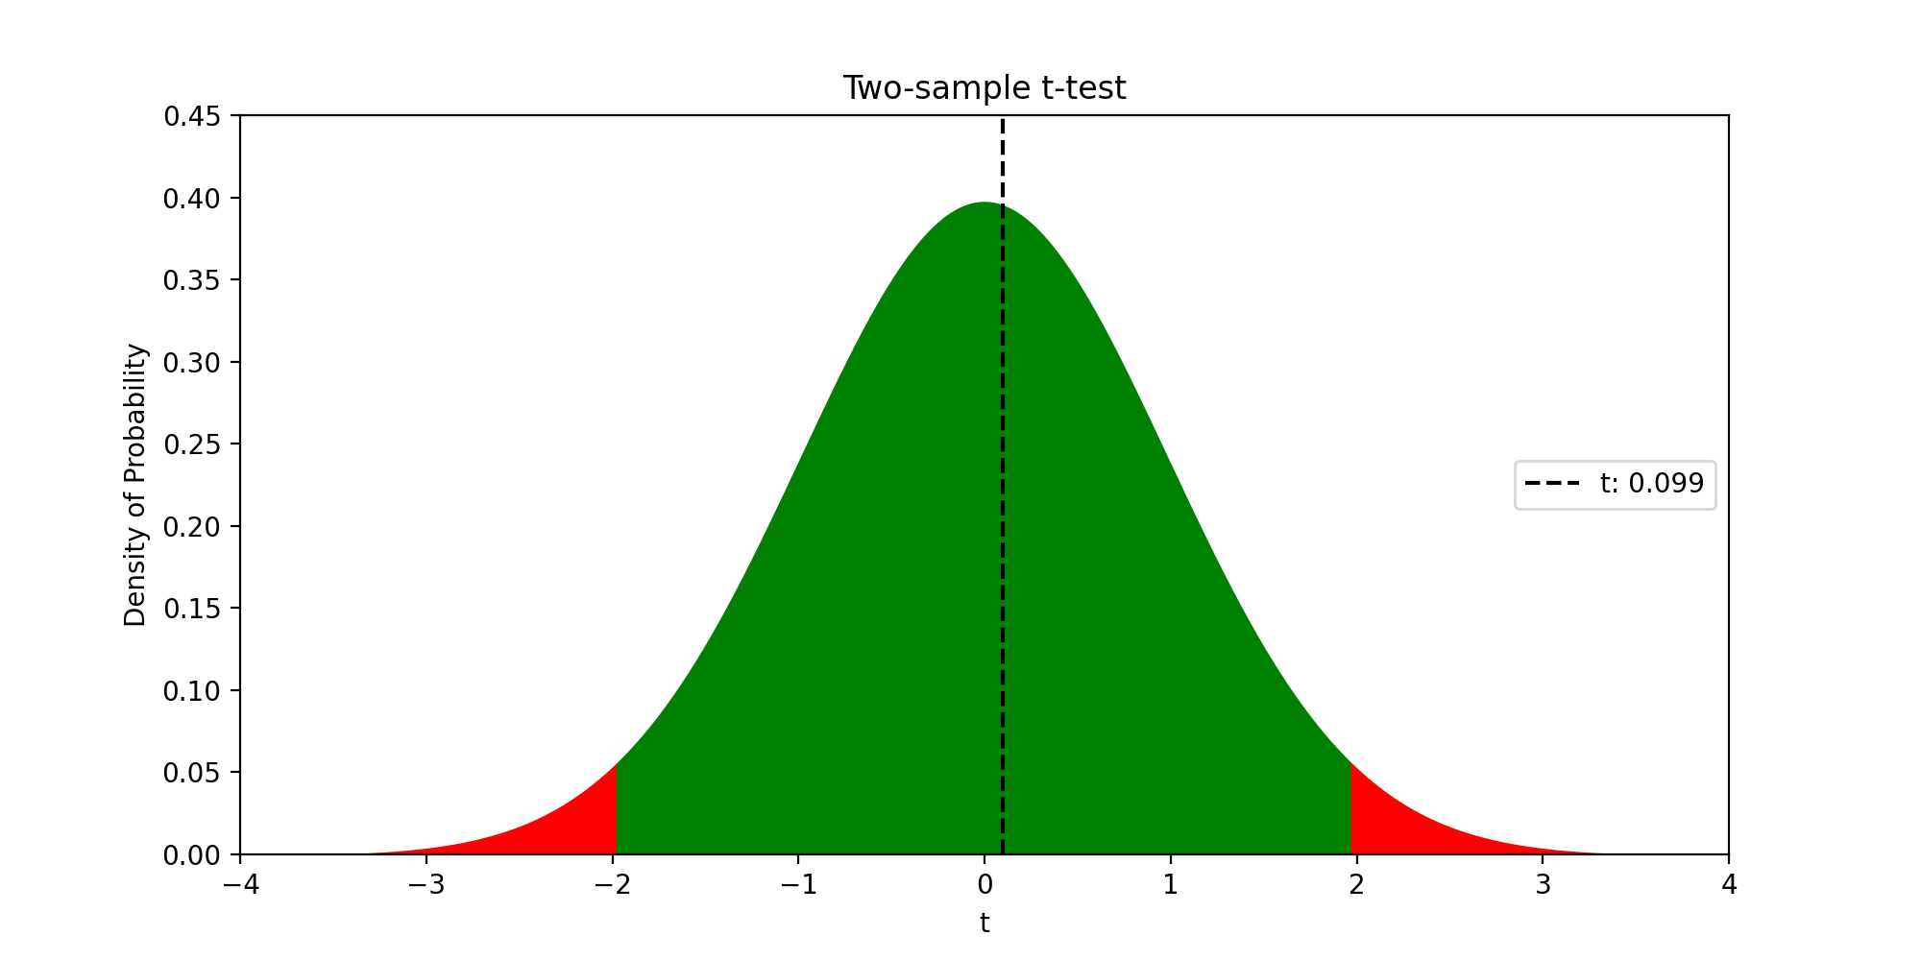
4 - Statistical testing :
Comparing two different mean of rising temperatures from two different countries.
H0: The mean annual temperature increase in the USA is the same as in China. Significance level: 5%
We conclude that the data supports the assumption that the mean annual temperature increase in the USA is the same as in China.
Notes:
We chose USA and China because they have approximately the same GDP and they are in the top 10 of CO2 emissions.

Slide 9
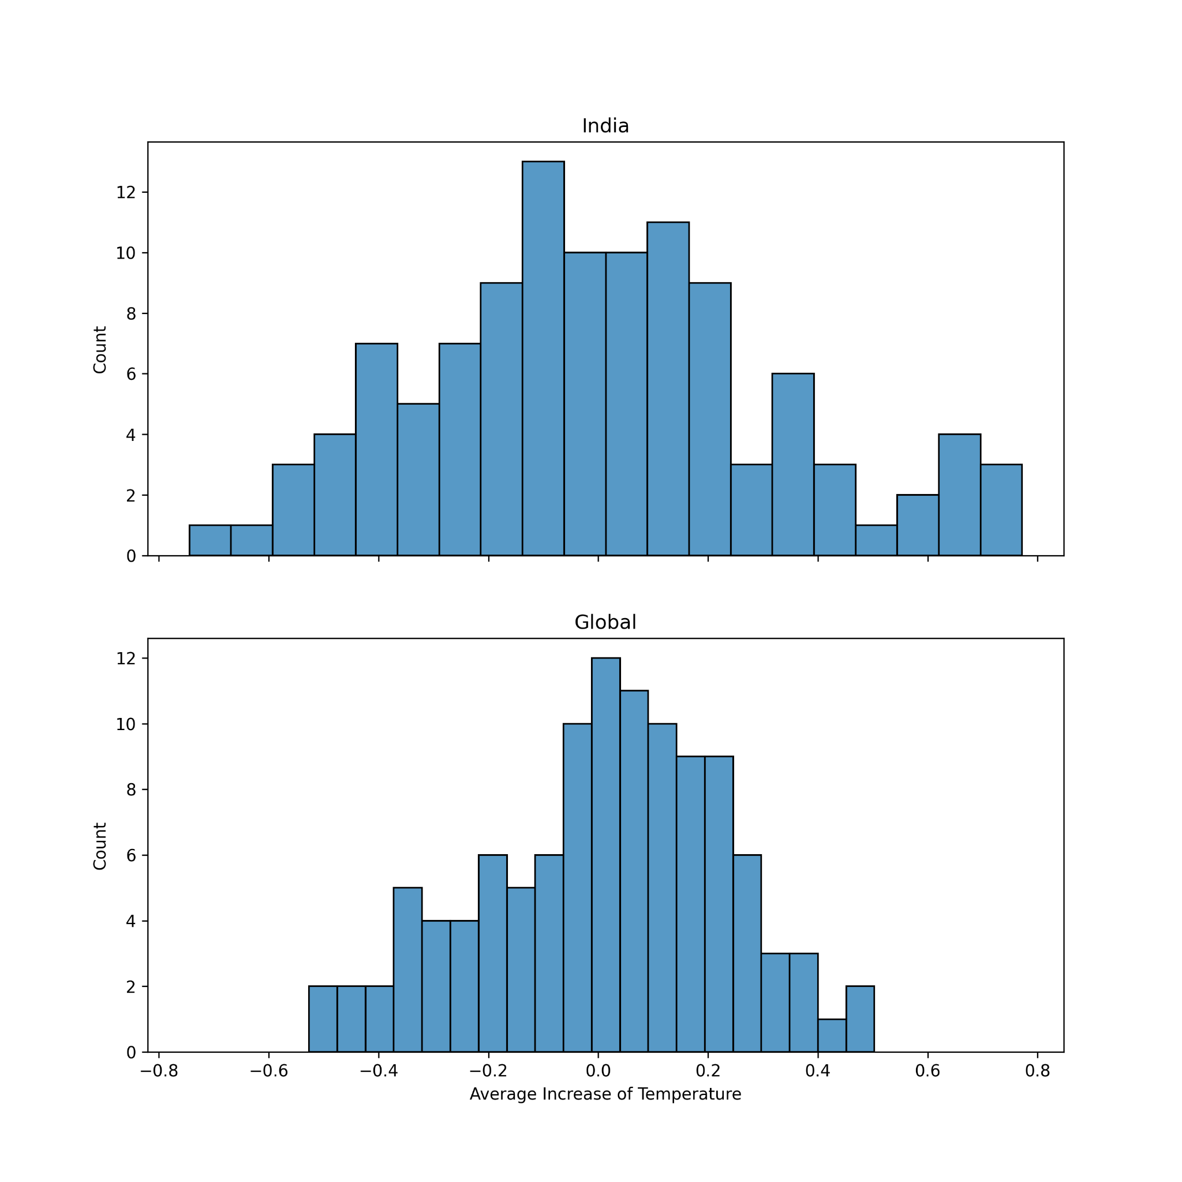

5 - Statistical testing :
Comparing the global average temperatures and a specific country average temperatures.
H0: The mean annual temperature increase in India represents the global mean. Significance level: 5%
We conclude that the data supports the assumption that the mean annual temperature increase in India is representing the global mean.
Notes:
We chose India because we wanted to find out if the country with the lowest increase in temperature of the top 10 countries also represented the global increase in temperatures.

